Slide 1
Oral Health in Maryland
Florida Oral Health Conference
The Nuts and Bolts of Coalitions
August 23, 2012
Penny Anderson, M.S.W.
Executive Director

Slide 2
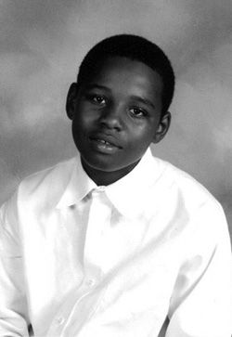
Maryland Dental Action Coalition:
Our History
Initially established as Dental Action Committee (DAC) by Maryland’s Secretary of Health and Mental Hygiene in 2007
A state response to the death of 12-year-old Deamonte Driver
Developed recommendations to improve the oral health of children in Maryland

Slide 3
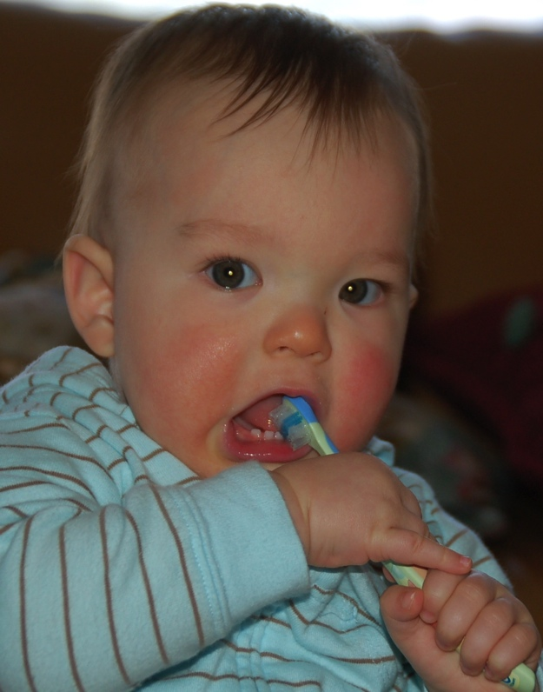
Maryland Dental Action Coalition:
Our Development
Transitioned into a state coalition in late 2009
Now called the Maryland Dental Action Coalition (MDAC)
Broad based group committed to improving oral health of all Marylanders
Maryland Office of Oral Health funded transition through a CDC State Oral Health Infrastructure grant
Notes:
Maryland Dental Action Coalition: Our Development
Transitioned into a state coalition in late 2009
Now called the Maryland Dental Action Coalition (MDAC)
Broad based independent group of organizations and individuals committed to improving the oral health of all Marylanders (talk about diversity of members and nontraditional partners) Members represent academia, advocacy, dentistry, government, medicine, public health, social services, students, and others – media
Maryland Office of Oral Health funded transition through a CDC State Oral Health Infrastructure grant

Slide 4

Maryland Dental Action Coalition:
Our Support
Operational support through a grant from the DentaQuest Foundation
Infrastructure support from the Maryland State Dental Association
Notes:
Maryland Dental Action Coalition: Our Support
Operational support through a grant from the DentaQuest Foundation
Infrastructure support from the Maryland State Dental Association

Slide 5
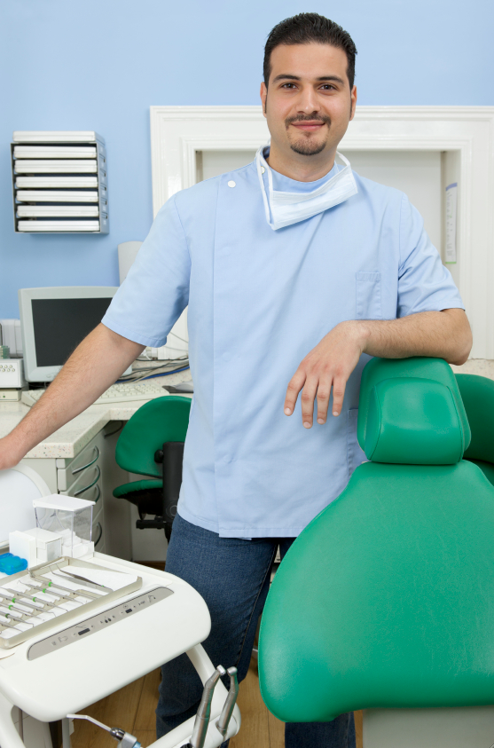
The Development of Coalitions
Intentional (Proactive)
  Issue or program
  Research/new thinking
  Learn
  Expand/broaden
  Replicate
Circumstantial (Reactive)
  Facilitating event

Slide 6
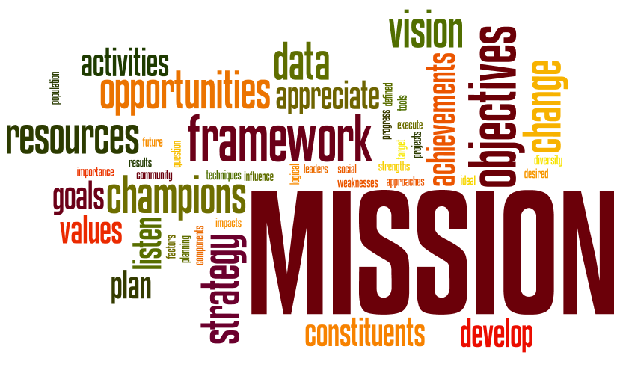
Purpose of Coalitions
Promote a common goal or purpose!
Increase awareness and knowledge
Address specific problems or issues
Influence policy and program development
Create synergy

Slide 7

Key Functions
Tackle oral health needs of residents
Plan and prioritize
Communicate
Educate
Advocate
Encourage networking
Experiment
Provide oversight
Notes:
Key Functions
Plan and prioritize (DAC recommendations, MOHP, public policy tool, MDAC strategic plan)
Advocate (public policy agenda - single, unified voice for those in need)
Communicate (among and between and with Marylanders)
Educate (ourselves and others)
Experiment
Network
Ensure DAC recommendations are implemented and monitor outcomes
Tackle issues concerning residents from all walks of life to:
increase access to oral health care
prevent oral disease and injury
increase oral health literacy in Maryland

Slide 8
MDAC Mission
To develop and maintain a statewide partnership of individuals committed to improved health among all Marylanders through increased oral health prevention, education, advocacy and access to dental care.

Slide 9
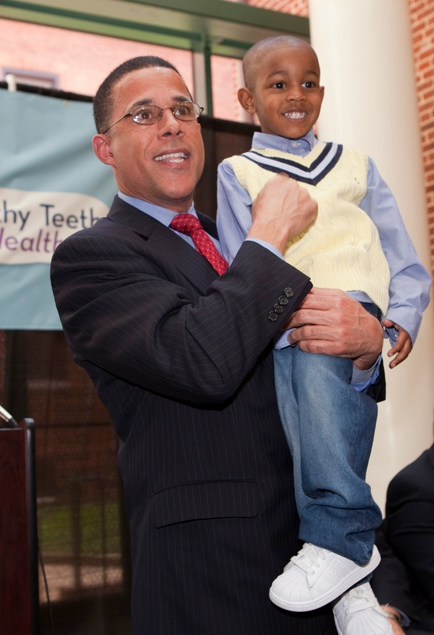
State vs. Local Coalitions
Both are Important
State Coalitions
Obtain and synthesize local level information and input
Establish statewide agenda
Provide strong, unified voice for oral health
Develop/coordinate statewide activities and messages
Gather, analyze, and disseminate national and state level data and information
Facilitate networking and partnership development

Slide 10

State vs. Local Coalitions
Both are Important
Local Coalitions
Gather and share local data/information
Develop local relationships
Implement action at the local level
Test or pilot local projects/ideas/activities
Provide input/feedback to statewide efforts
Provide representation to state organization

Slide 11
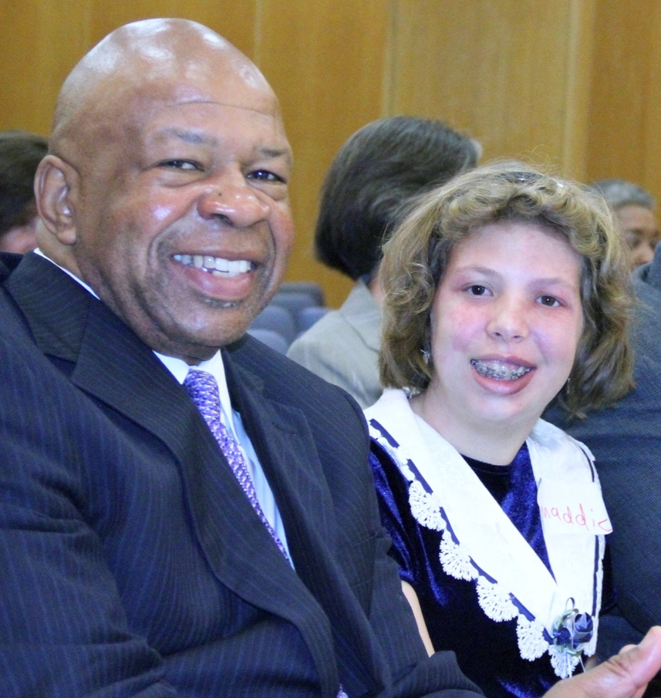
Bringing People to the Table
Motivating Factors
Crisis or negative event
Common vision and goal
Strong leadership
Personal relationships
Peer involvement
Personal and professional agendas left at the door
Desire to be part of something successful
Notes:
What Motivated/s People to Participate? Brought People to the Table?
Strong leadership (Colmers, OOH, legislators – state and federal, funders)
Personal ask
Common goal/vision – to maximize the oral health of all Marylanders (initially just kids, now all; to make a difference)
Agreement to leave personal agendas at the door (use our 3 MOHP goals as filter)
Peer involvement
Want to be part of something successful

Slide 12
Organizational Issues to Consider
Grounded in purpose; goals; common ground
Scope
Membership
Structure
Governance
Motivational factors
Levels of involvement
Recruitment strategies
Decision-making
Communication
Support
Assessment
Sustainability
Presence

Slide 13

Expectations of a Coalition
Stay focused on mission
Be inclusive within the boundaries of the coalition’s stated purpose and goals
Appreciate the motivations, values, abilities of each member
Maintain openness and transparency
Prioritize work
Communicate regularly
Evaluate frequently
Respect members’ time

Slide 14

Expectations of Coalition Members
Promote mission
Mind collective interests
Set aside individual agendas
Be inclusive
Accept differences
Be respectful
Arrive prepared
Participate constructively
Support the organization

Slide 15
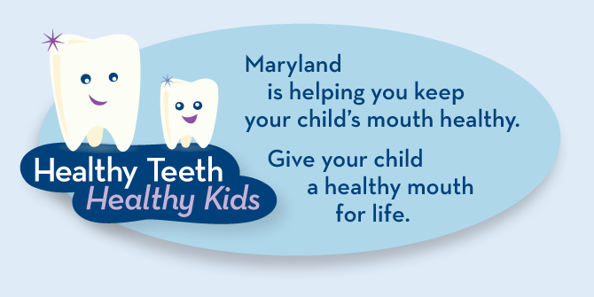
Opportunities/Successes
Make a difference
Broaden the reach
Raise awareness
Learn and grow
Address issues together
Test new ideas and approaches
Advocate
Educate
Use data effectively

Slide 16
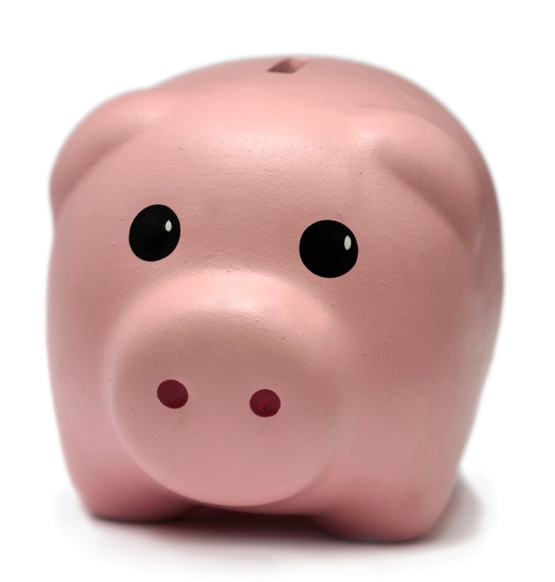
Challenges
Communicating effectively
Staying attuned to members
Finding roles for all members
Managing individual agendas
Hearing everyone
Gaining consensus
Staying true to mission
Using data effectively
Planning for sustainability

Slide 17
Strengthening Coalitions
Stay focused on mission
Communicate
Ask for help
Bring in new voices
Find your champions
Tap into available expertise and resources
Keep members involved
Know your limitations
Act on feedback and suggestions
Listen
Embrace learning and growth
Communicate
Recognize contributions
Celebrate successes

Slide 18
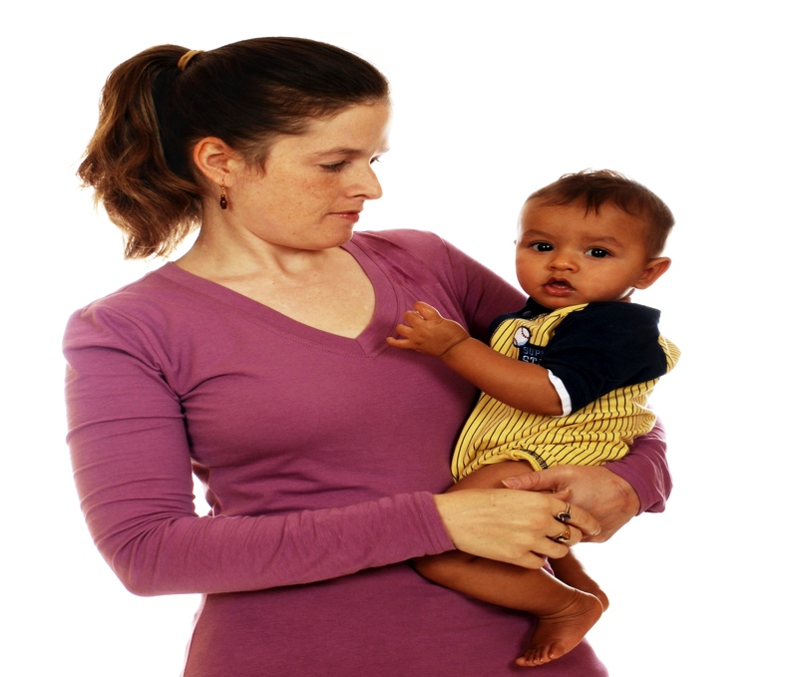
In a Nutshell, MDAC Is…
A voice for oral health in Maryland and the Nation
A convener of partners
A vehicle for collaboration and learning
A conduit of information
A leader in the national debate on oral health
A diverse group committed to promoting and guiding the work to maximize the oral health of all Marylanders
Notes:
In a Nutshell, MDAC Is…
A voice for oral health in Maryland and the Nation
A convener of partners
A vehicle for collaboration and learning
A conduit of information
A leader in the national debate on oral health
A diverse group committed to promoting the guiding the work to maximize the oral health of all Marylanders

Slide 19
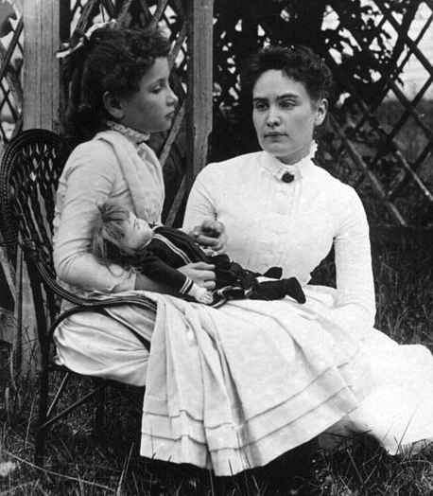
“Alone we can do so little;
Together we can do so much.”
Helen Keller

