Slide 1
Lake County Health Department
School-Based
Dental Sealant Program/
Smiles for Lake County Oral Health Coalition
Dr. Elizabeth Orr, Senior Dentist

Slide 2
History of the Program
First year (2008): Lake County Health Department (LCHD) leased a Mobile Dental Unit for 6 months and completed 4 schools.
Second year (2009): LCHD purchased its own Mobile Dental Unit and completed 10 schools.
Third Year (2010): 14 schools completed
Fourth Year (2011): 16 schools completed
Fifth Year (2012): Scheduled for 14 schools, including 2 alternate schools

Slide 3
Community Support
The Lake County School District Director of Student Services facilitated the inception of the program in 2008.
Smiles for Lake County Oral Health Coalition started in August 2011 as a result of the outcomes of the School Sealant Program.
The current Director of Student Services continues to support the growth of the program along with coalition activities.

Slide 4
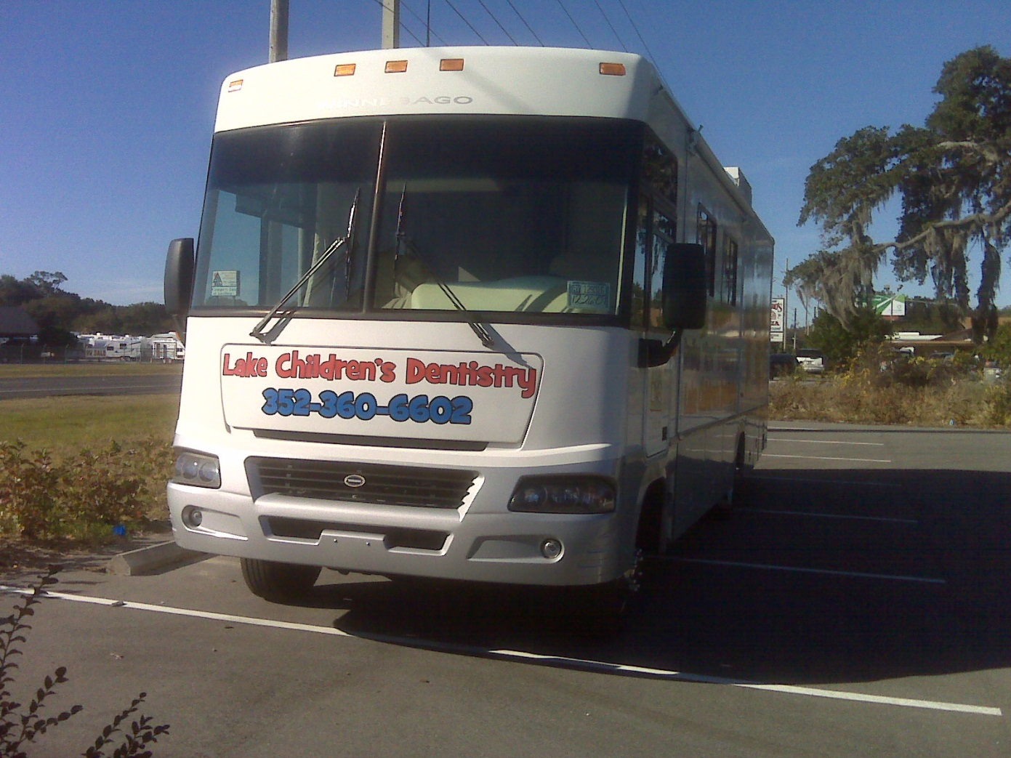
Introducing Toothy 2!

Slide 5
Introducing Toothy 2!

Slide 6
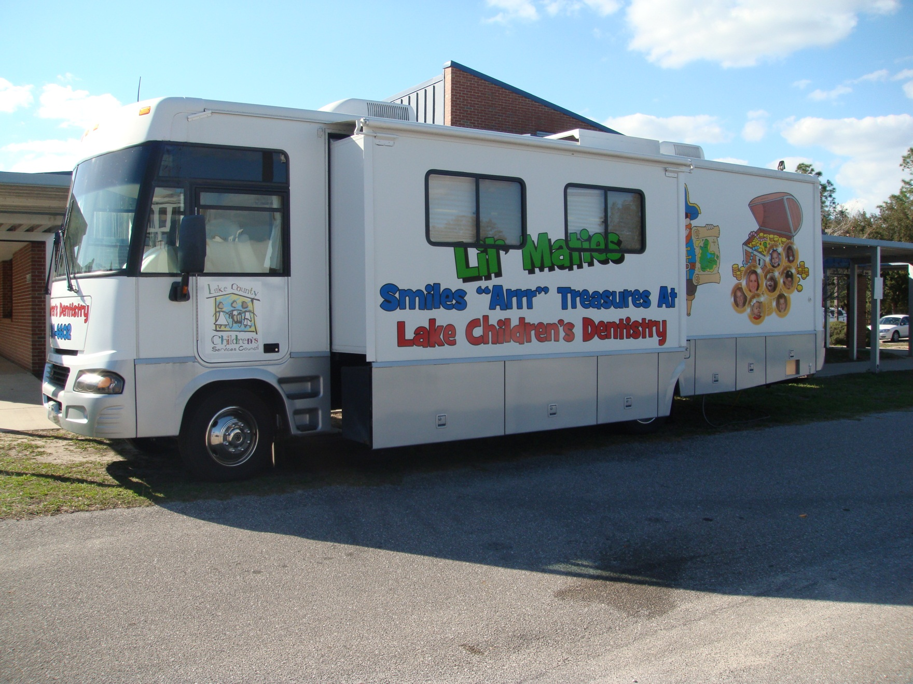

Slide 7
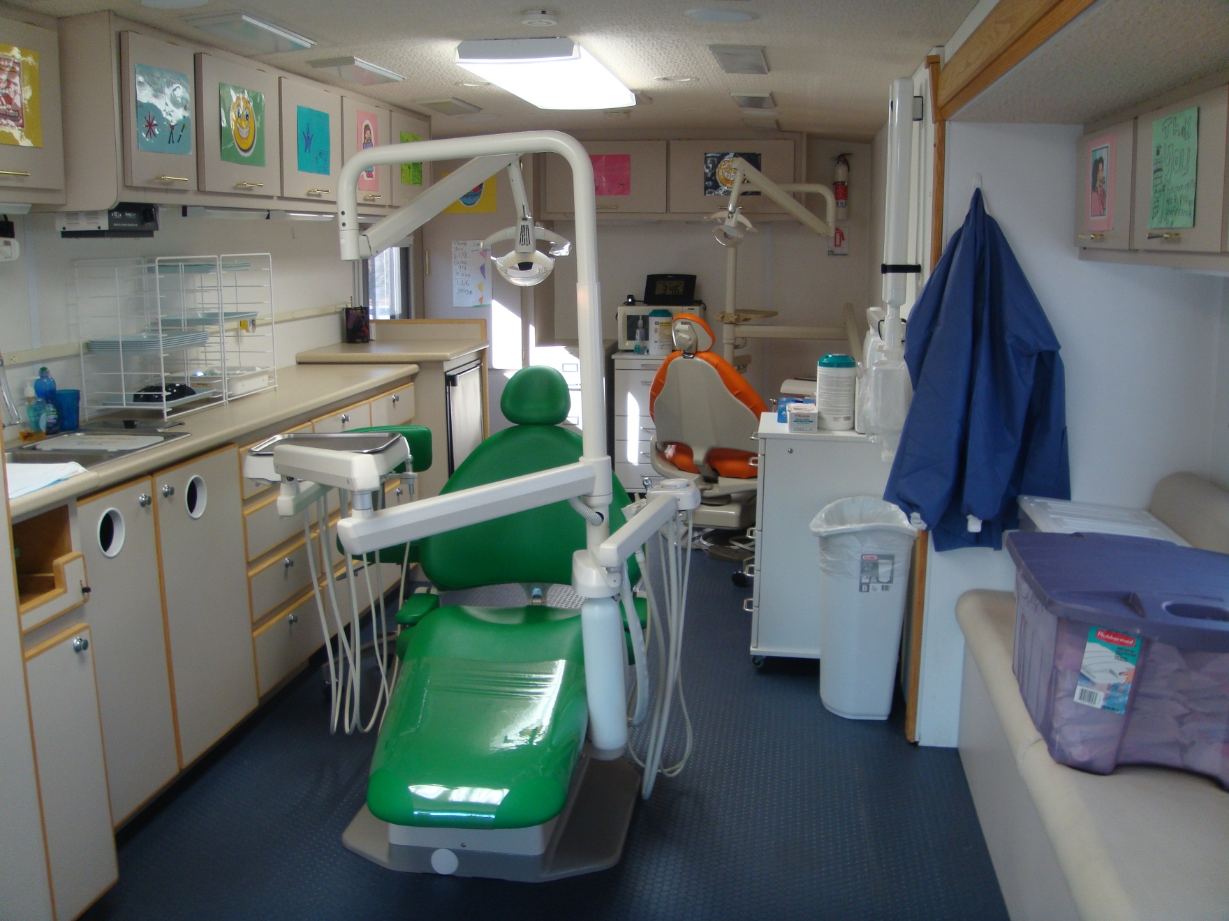

Slide 8
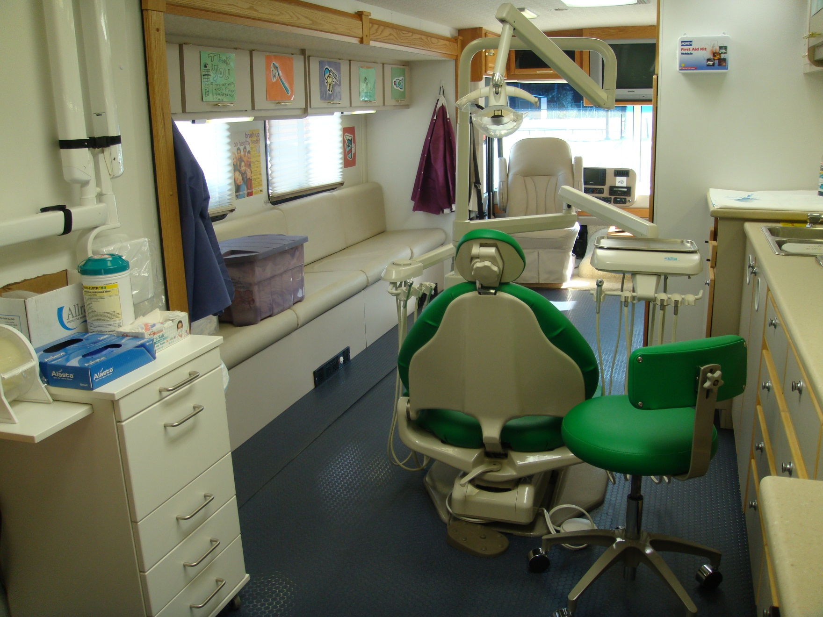

Slide 9
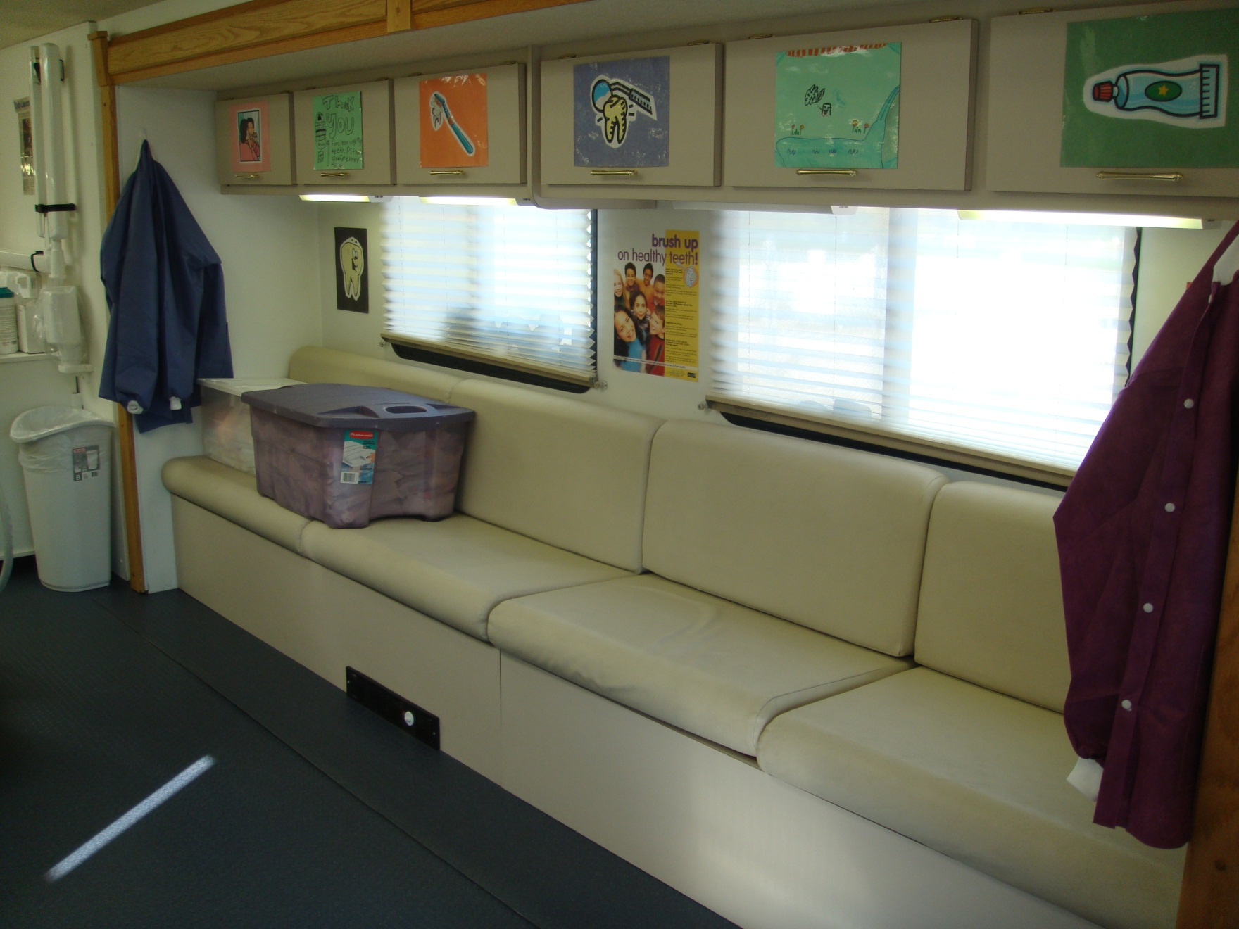

Slide 10
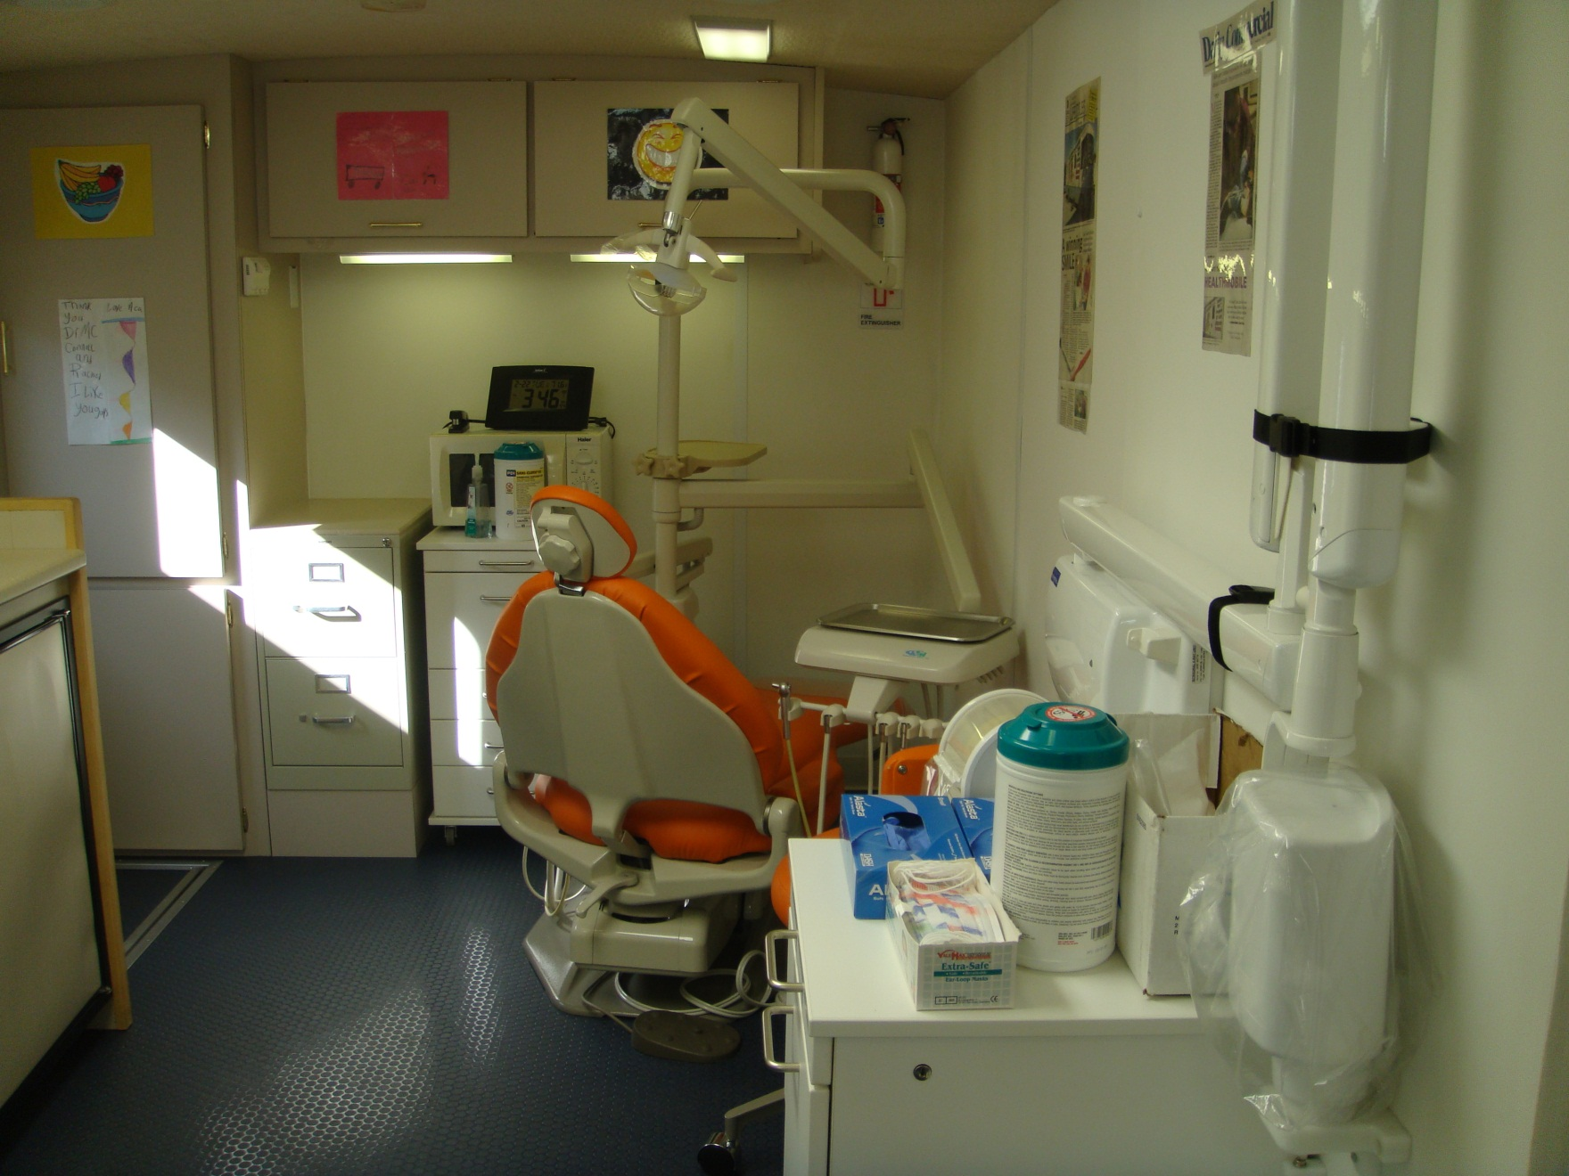

Slide 11
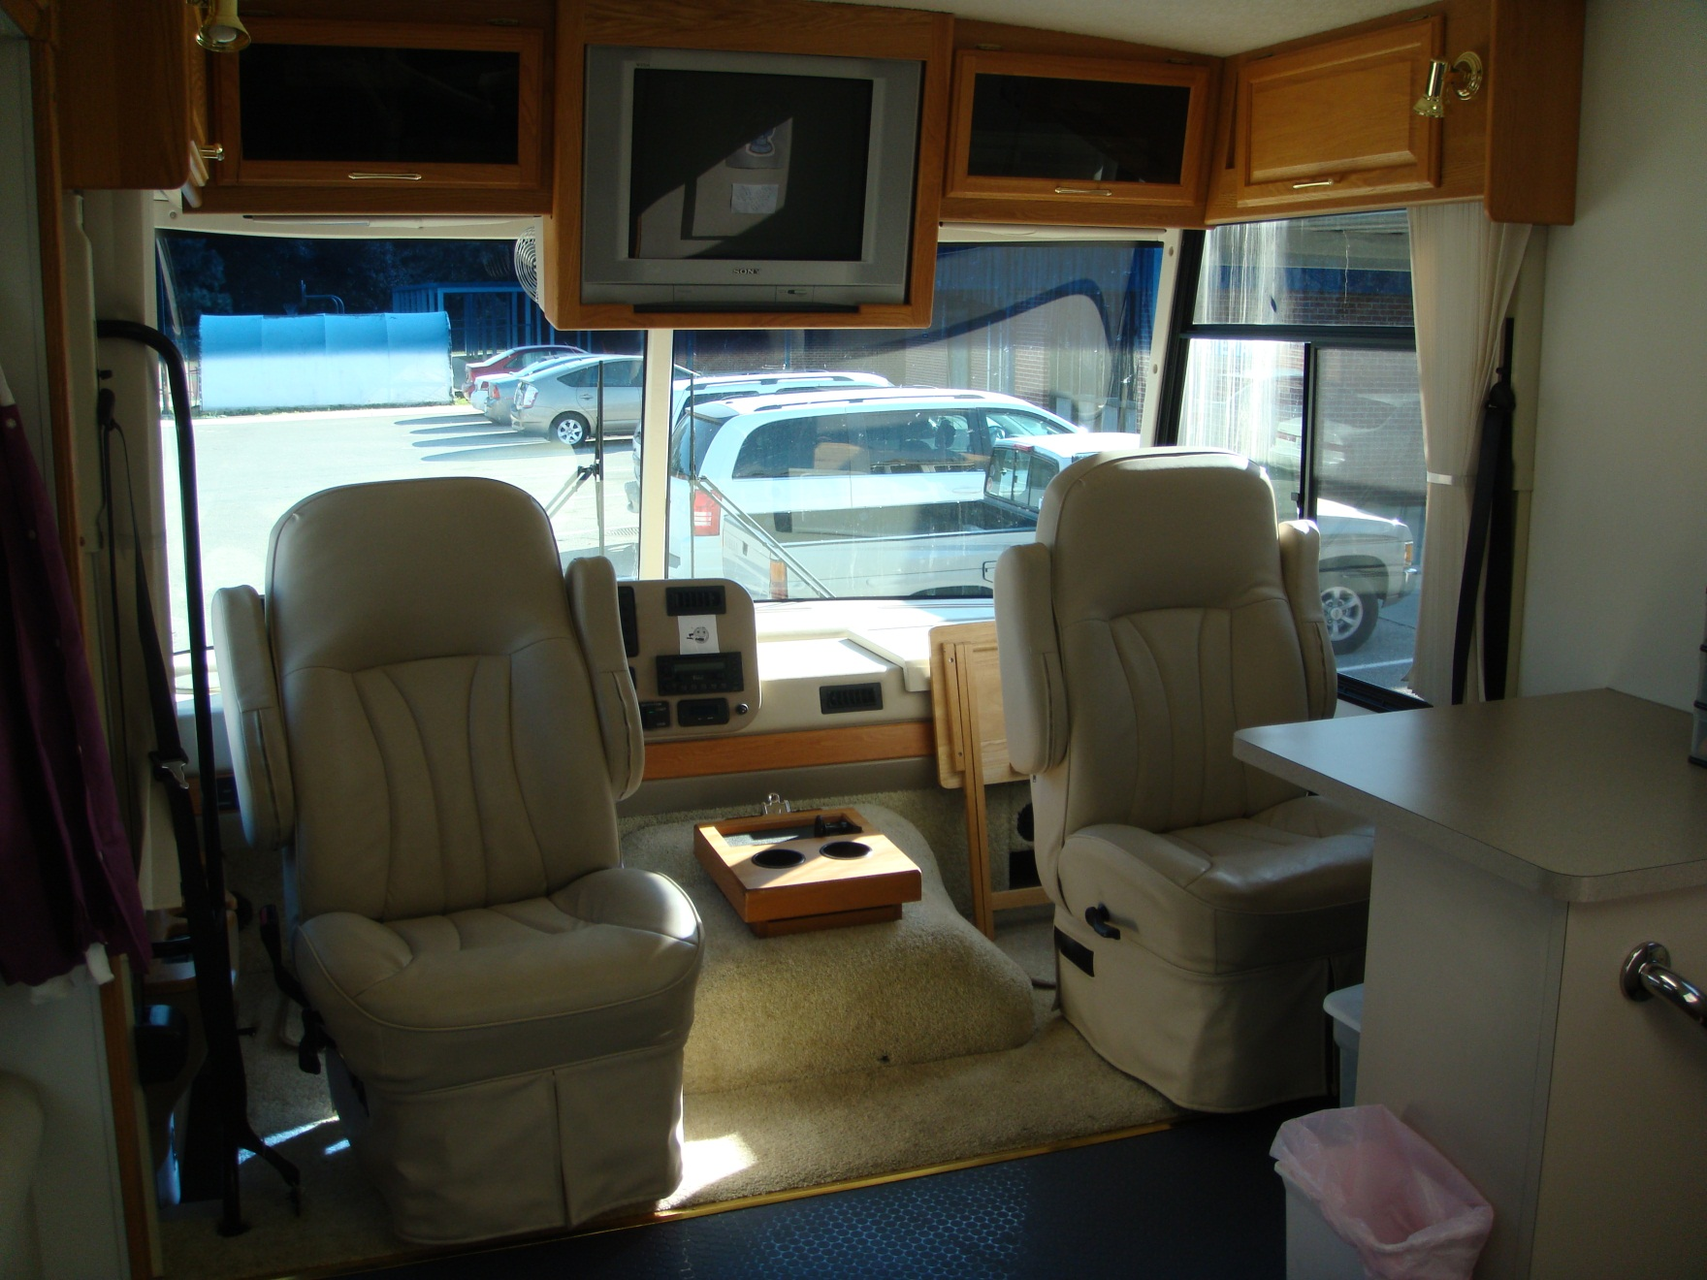

Slide 12
Toothy 2 Staff
Elizabeth Orr, DDS and Katherine Grady, DDS (alternate)
Dentists
Ashley Martin, EFDA, and Sharon Rehorn, EFDA (alternate)
Dental Assistants
Joleen Green
Clerical Supervisor
Joleen Green and Oscar Palau
Toothy 2 Drivers

Slide 13
Services Provided
School Year
(# of Schools)

Slide 14
Snapshot of Lake County
 | 2010-2011 School Year |  | 2011-2012 School Year
 | Total | Percentage | Total | Percentage
Existing Sealants | 168 | 22% | 245 | 26%
Existing Fillings | 255 | 33% | 355 | 37%
No dental work | 444 | 58% | 511 | 53%
Acute Conditions | 27 | 4% | 37 | 4%
Routine Diagnostic | 348 | 46% | 392 | 41%
Routine Minor Problem | 277 | 36% | 343 | 36%
Severe Problems | 130 | 17% | 183 | 19%
Sealants Placed | 650 | 85% | 834 | 87%
Behavior Problems | 30 | 4% | 43 | 4%
Unerupted molars | 33 | 4% | 120 | 13%

Slide 15
School-Based Dental Sealant Program
Processes and Procedures

Slide 16
School Selection Process
During the summer prior the school year commencing, a meeting is held with the Director of Student Services to target the schools which have more than 70% of students on the Free and Reduced Lunch Program.
There are also alternate schools identified that have between 60-70% of students on Free and Reduced Lunch Program. Alternate schools are included in the schedule if time allows after the targeted schools are completed.

Slide 17
Before Toothy 2 Arrives…
Make initial contact with the School Nurse and Administration
Schedule one to three weeks depending on size of second grade class
Face-to-Face meeting with School Nurse and Administration
Program overview
Select location for mobile unit
Deliver parent permission packets for 2nd Grade students only
Deliver informational letters for the parents of 3rd Grade students who received sealants the previous school year
Retrieve completed parental permission packets
School enlists volunteers/teaching assistants to escort students to and from Toothy 2

Slide 18
Ideas to Promote the Sealant Program
Call all parents to ensure they received a permission packet
List dates and include link to print paperwork on School’s Website
Write an article in the School Newsletter (or include Toothy 2 flyer)
Advertise dates on School Marquee
Post Toothy 2 flyer in office, classrooms, and nurse’s office
Sponsor pizza party or prizes for the class that returns the most packets
Include a morning announcement to remind students to return completed packets to their teachers
Highlight and write dates on the packets

Slide 19
After Retrieving the Parental Permission Packets…
LCHD Clerical Supervisor:
Verifies signatures on all 3 forms (Parental Permission Form, Medical History Form, and Initiation of Services Form)
Enters client information into the Health Management System and checks for Medicaid status or designates grant eligibility
Creates Excel spreadsheets listing all children participating, grouped by teacher, and saves it to our shared network drive that can be accessed from the mobile unit to facilitate billing
Produces a patient chart for each completed packet including:
Comprehensive Exam Form
Progress Note
Parent Letter of Services Provided/Needed
All Forms Available on http://www.floridaoralhealth.com/sealant-program
*This process is for 2nd Grade students

Slide 20
3rd Grade Reseals
Parents have already given permission for their child to be seen as a 3rd Grader on the 2nd grade parent permission forms
We will only see 3rd grade students who had sealants placed the previous year on the Toothy 2
The School Nurse provides the 3rd Grade teacher name in order update the chart
LCHD Clerical Supervisor creates a separate Excel spreadsheet for 3rd Grade reseals and adds a recall exam sheet and a new Parent Letter of Services Provided/Needed to the existing chart
At this time, we do not provide prophylaxis (teeth cleaning), fluoride, and oral hygiene instruction for 3rd Grade students

Slide 21
After Toothy 2 Arrives…
Volunteers/Teaching Assistants escort students to Toothy 2 in groups of 2-4, based on a preset schedule:
Day 1 & 2:
Toothy 2 setup
Visual Exams for 2nd and 3rd Grade
Day 3 & 4:
Oral Hygiene Presentations/Brushing & Flossing Instructions
Prophylaxis
Fluoride Varnish Application
Remaining Days:
Application of Sealants to 6-Year Molars for 2nd Graders
Re-application of Sealants for 3rd Graders (if applicable)
Final Day:
Distribute Parent Letter of Services Provided/Needed to the teachers to be sent home to parents
Prepare Toothy 2 for departure

Slide 22
School-Based Dental Sealant Program
LCHD Flyers

Slide 23
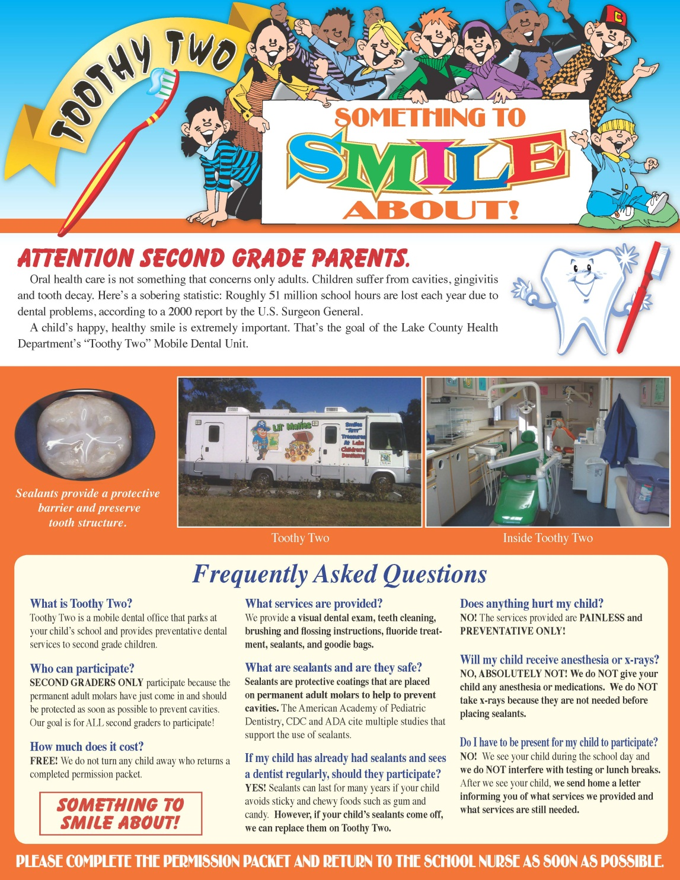
Toothy 2 Flyer

Slide 24
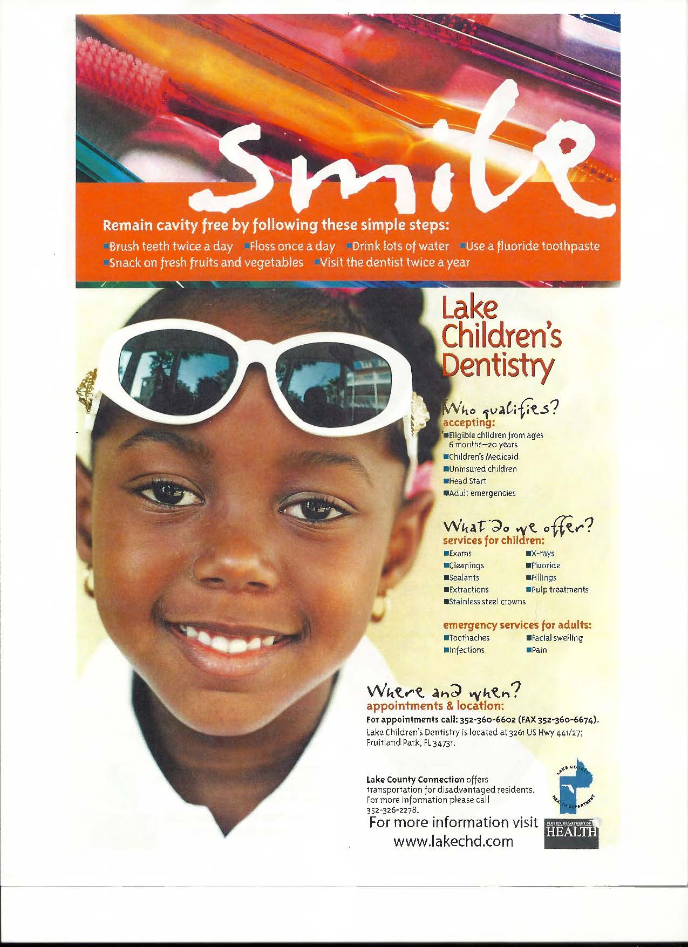
Clinic Referral Flyer

Slide 25
School-Based Dental Sealant Program
EXTRA! EXTRA!

Slide 26
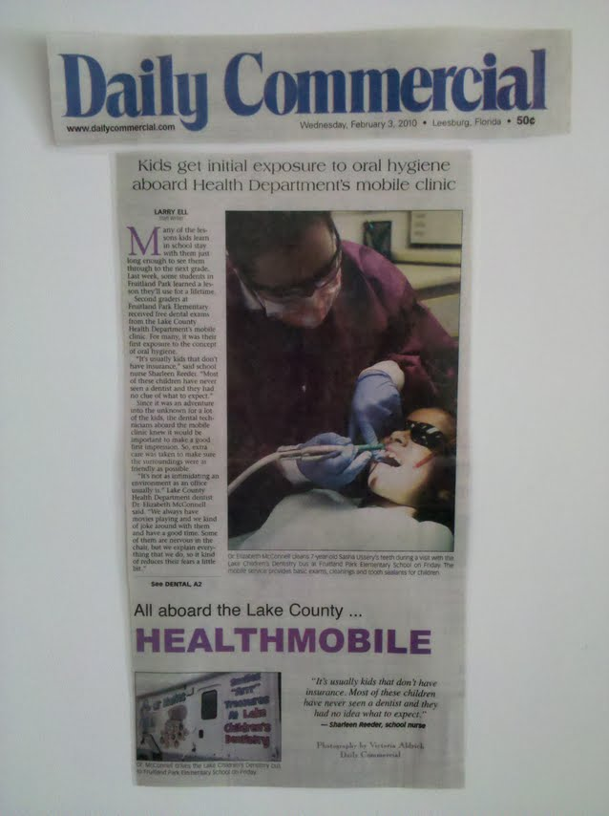
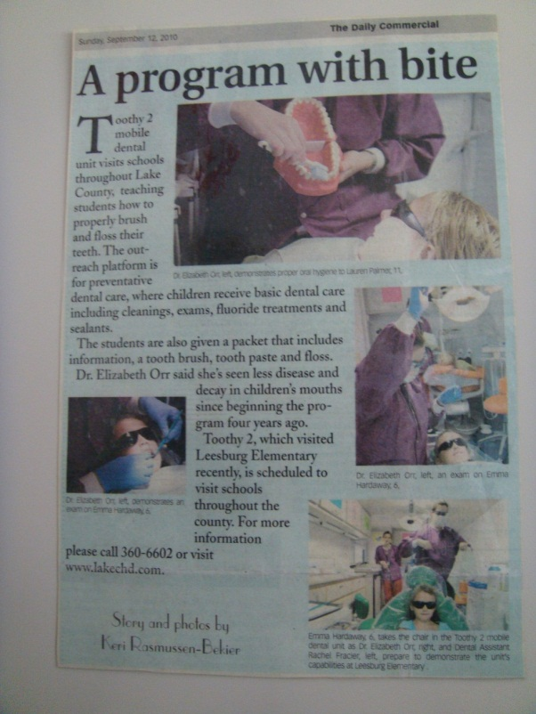
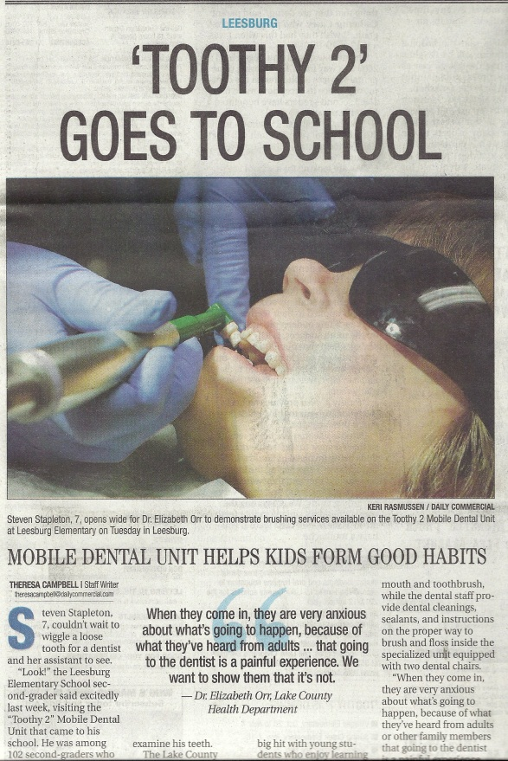
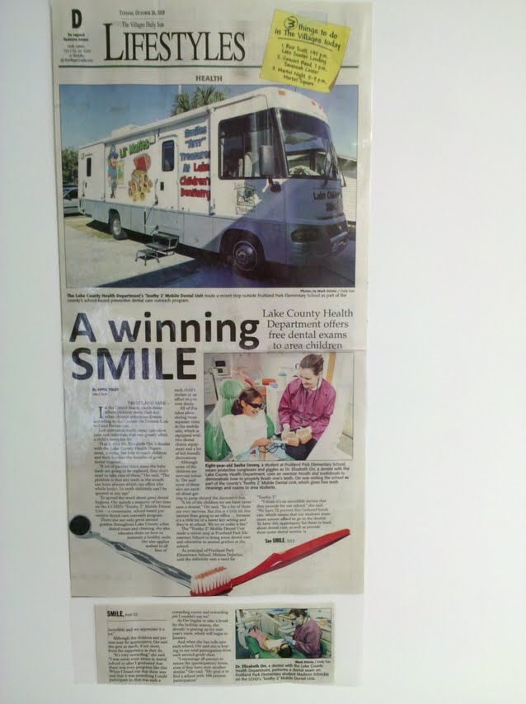

Slide 27
Awards and Recognitions
Prudential Davis Productivity Award
June 2012
Best Practices Award
July 2012

Slide 28
Lake County Health Department
Thank you for
your Attention!

