Slide 1
A Prevention Agenda To Improve Children’s Oral Health
Matt Jacob
Florida Oral Health Conference
August 23, 2012

Slide 2
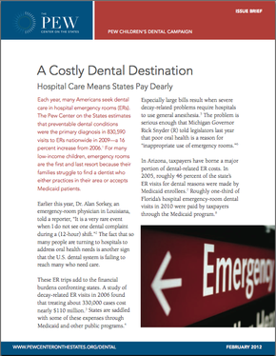
The impact of unmet dental needs
Preventable dental conditions were the primary diagnosis in 830,000+ visits to hospital ERs nationwide in 2009 — a 16% increase from 2006.
Children accounted for nearly 50,000 of these ER visits.
Many ER visits are made by Medicaid enrollees and the uninsured, meaning these visits impose a cost on taxpayers and consumers.
Florida: The number of Medicaid enrollees seeking ER care for dental problems jumped 40% over a two-year period.
2

Slide 3
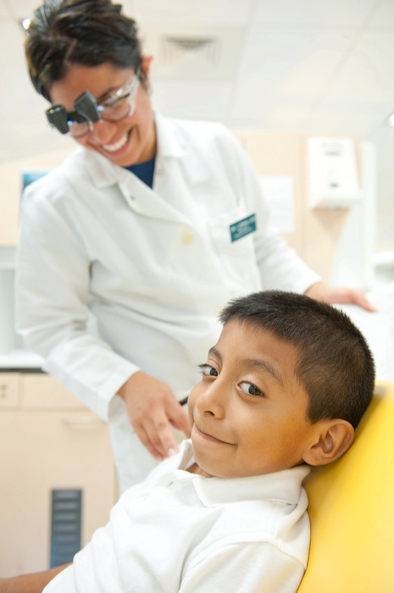
The driving factors
More than 100 million Americans lack dental insurance.
States are not investing enough in proven forms of prevention.
Inadequate Medicaid funding leaves big gaps in coverage.
The dental workforce lacks the capacity to address all of the unmet need.

Slide 4
Better Use of Prevention: – Fluoridation – Dental Sealants

Slide 5
Community water fluoridation
Community water fluoridation is endorsed by the American Academy of Pediatrics, the American Dental Association and other leading health authorities.
Fluoridated water reduces tooth decay by 25%.
It’s the most cost-effective oral health intervention. Every $1 invested in water fluoridation saves $38.
Source: Centers for Disease Control and Prevention, www.cdc.gov/fluoridation

Slide 6
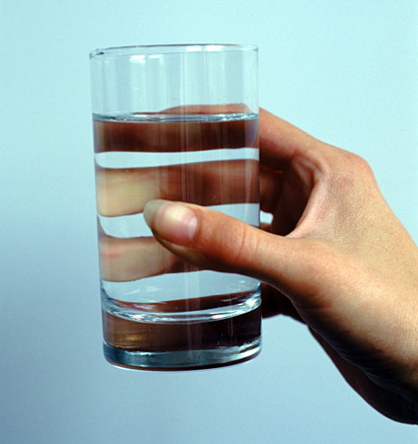
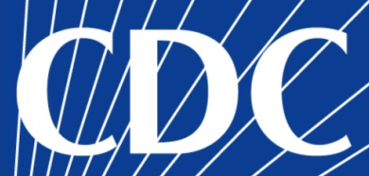
Slow, steady growth for fluoridation
Millions of Americans on Public Water Systems Who Receive Optimally Fluoridated Water
210
200
190
180
170
160
150
140
130
120
1988 1992 2000 2002 2004 2006 2008 2010
Year of Fluoridation Data
CDC named community water fluoridation one of “10 great public health achievements of the 20th century.”

Slide 7
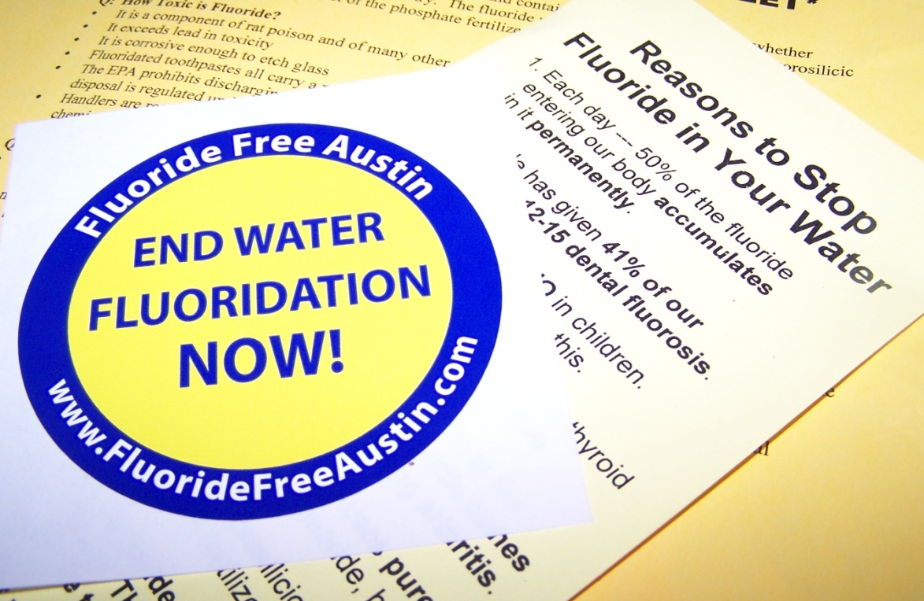
But this is no time to celebrate
72 million Americans do not receive community water fluoridation (CWF). In many states, anti-fluoride activists are trying to stop CWF, ending a proven strategy to prevent tooth decay.
l
Tennessee’s Speaker of the House publicly urged state officials to stop promoting CWF.
In Nebraska, 80% of the towns voting chose to opt out of a fluoridation law (2008-2010).
One of Florida’s largest counties voted in 2011 to discontinue CWF.
l
l

Slide 8
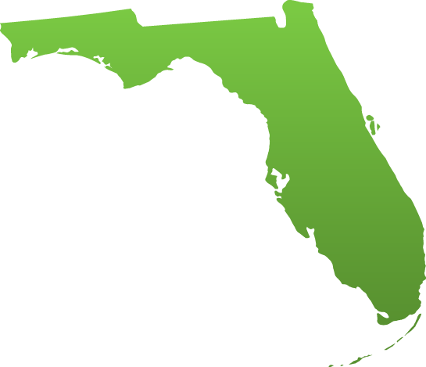
How does Florida measure up?
Florida ranks 25th out of the 50 states in the percentage of residents receiving optimally fluoridated water.
More than 3.7 million Floridians live in homes with no access to CWF.
Fluoridation debate has been very intense in Florida over the past 12 months
l
l
l
8

Slide 9
Pew’s research on fluoridation
Media analysis of newspapers, social media and search-engine results
Research of opposition messages used online and in social media
Focus groups and interviews with stakeholders in communities where fluoridation has been hotly debated in recent years
Palm Beach, FL; Wichita, KS; York, PA; and San Diego, CA
National survey of the public
Message testing of pro- and anti-fluoridation leaflets with groups of “active citizens”
Focus groups of water operators in Mississippi

Slide 10
Fluoridation: Lessons Learned

Slide 11
Public awareness is low
How Informed Are You About Fluoridation? Survey of 1,503 adults (2010)
Very Informed | 20%
Somewhat Informed | 54%
Not at All Informed | 26%
Maryland survey: 58% of residents could not identify the purpose for adjusting the fluoride in public drinking water.
80% of Americans admit they have a low level of knowledge about fluoridation.

Slide 12
Public awareness is low
How Informed Are You About Fluoridation? Survey of 1,503 adults (2010)
Very Informed | 20%
Somewhat Informed | 54%
Not at All Informed | 26%
Maryland survey: 58% of residents could not identify the purpose for adjusting the fluoride in public drinking water.
80% of Americans admit they have a low level of knowledge about fluoridation.

Slide 13
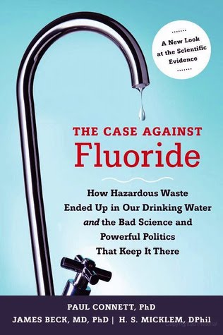
Opponents: Persistent and web-savvy
Opponents
are aggressively posting web content, courting media coverage and circulating anti-fluoride videos.

Slide 14
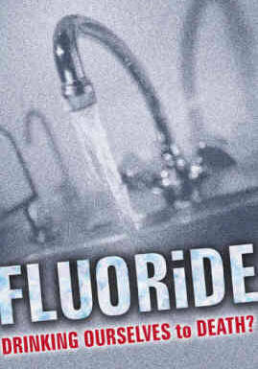
Comparing each side’s tactics
They are speaking to the public and successfully targeting key audiences.
They use ordinary language to spread fear and doubt.
They have a strong presence online and in social media.
We are more likely to communicate through conferences and list-servs.
We often use clinical language and don’t do much to correct distortions.
We have a relatively low profile on the web and in social media.
Water Fluoridation:
A Corporate-Inspired Scam

Slide 15
A perfect storm
The vacuum of public knowledge gets filled by the misinformation online
The growing distrust of government’s role in health or other issues
The public health community is complacent
Opponents have learned to package their arguments as science

Slide 16
Takeaway: Avoid clinical language
Dental Health and Fluoride Treatment
Debate Continues Over Fluoridation
Wichita’s water supply has sparked
a debate for decades that has pitted
health professionals against every-
day Kansans as to whether to flouridate it or not. “It's one of the most highly studied chemicals we've ever had," said Wichita dentist Dr. Brick Scheer.
Using the word “chemical” plays into the fear-based message of anti-fluoride activists

Slide 17
Takeaway: Frame the issue correctly
This is a winning message wheel for oral health advocates
Preventing
Decay
Better
Overall
Health
Kids and Adults Avoid Pain
Eat and
Smile with Dignity
Healthy
Reduce Health Care Costs
Teeth
Seniors Keep Their Teeth
Kids Miss Fewer School Days
Better Job
Prospects

Slide 18
Takeaway: Frame the issue correctly
Opponents are likely to win if the dialogue is trapped inside this message wheel
Fluorosis
Cancer
Lower
IQs
Bone Fractures
Arthritis
Hypo-
thyroidism
Harms
Risks
Kidney Problems
&
Alzheimer’s
Migraines
Nervous System
Problems
Violent
Crime
Autism

Slide 19
Takeaway: Lead with the need
Much Somewhat No
More More Effect
60% 26% 12%
39% 36% 21%
47% 35% 13%
31% 36% 20%
47% 38% 11%
How messages affect existing support:
More than 35% of children in Oregon have untreated dental disease.
The CDC has called fluoridation one of the “ten great public health achievements of the 20th century.”
Studies prove that fluoride prevents and can even reverse the process of tooth decay.
Communities have a moral obligation to ensure that all residents benefit from fluoride — something that is proven to improve oral health.
The typical city saves $38 for every $1 invested in water fluoridation.

Slide 20
Takeaway: Lead with the need
Much Somewhat No
More More Effect
60% 26% 12%
39% 36% 21%
47% 35% 13%
31% 36% 20%
47% 38% 11%
How messages affect existing support:
More than 35% of children in Oregon have untreated dental disease.
The CDC has called fluoridation one of the “ten great public health achievements of the 20th century.”
Studies prove that fluoride prevents and can even reverse the process of tooth decay.
Communities have a moral obligation to ensure that all residents benefit from fluoride — something that is proven to improve oral health.
The typical city saves $38 for every $1 invested in water fluoridation.

Slide 21
Takeaway: Lead with the need
Airing a TV ad in Portland that emphasizes the oral health problems

Slide 22
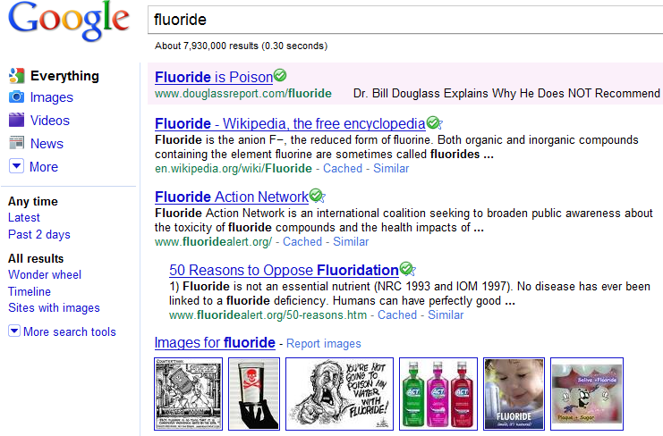
Takeaway: Start reclaiming the web

Slide 23
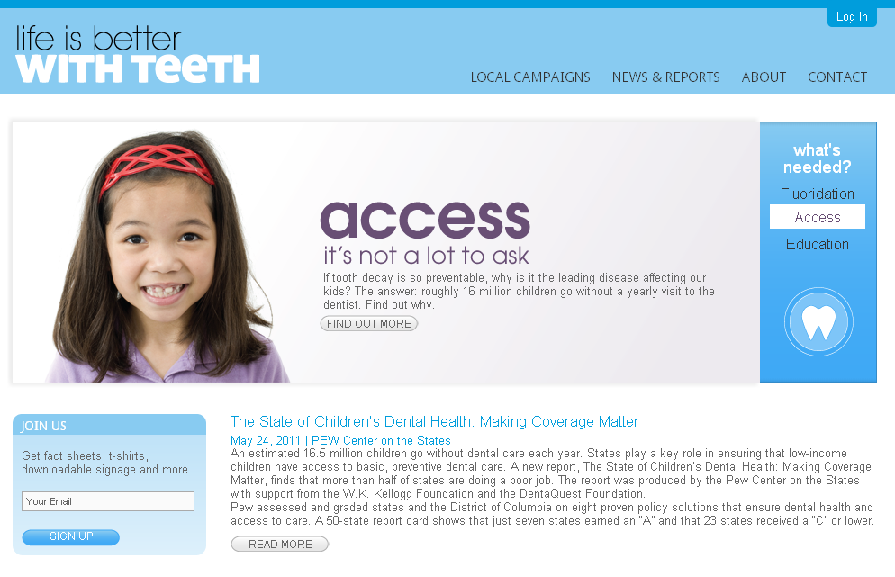
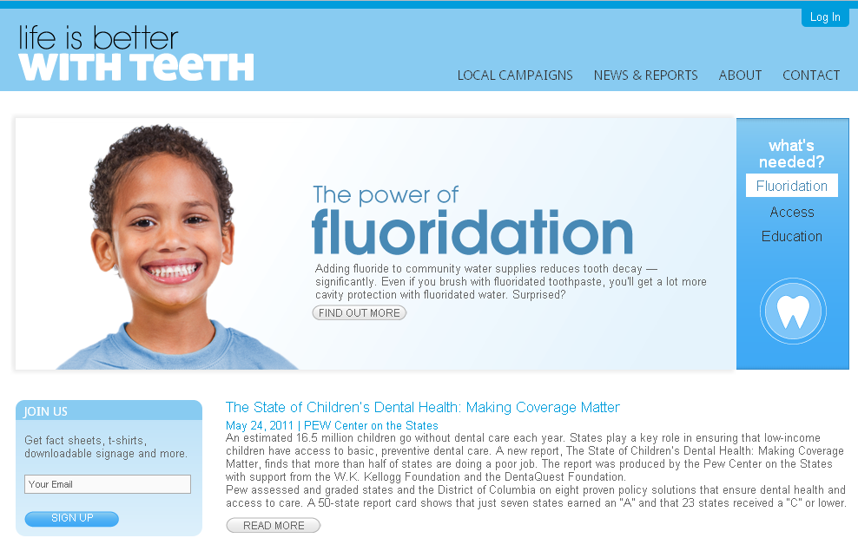
Takeaway: Start reclaiming the web
iLikeMyTeeth.org
frames CWF in the broader context of oral health (protecting teeth)

Slide 24
The Campaign for Dental Health (iLikeMyTeeth.org)

Slide 25
The Campaign for Dental Health
Objectives:
Create a national network of CWF advocates who can share ideas, offer insights, and support one another
Improve the quality and accuracy of web content about oral health and CWF
Provide state and local advocates with fact sheets, PowerPoint slides and other helpful resources to support their work

Slide 26
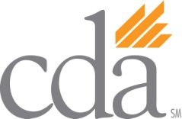
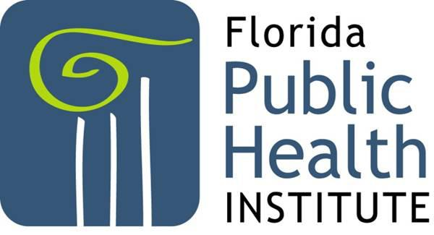
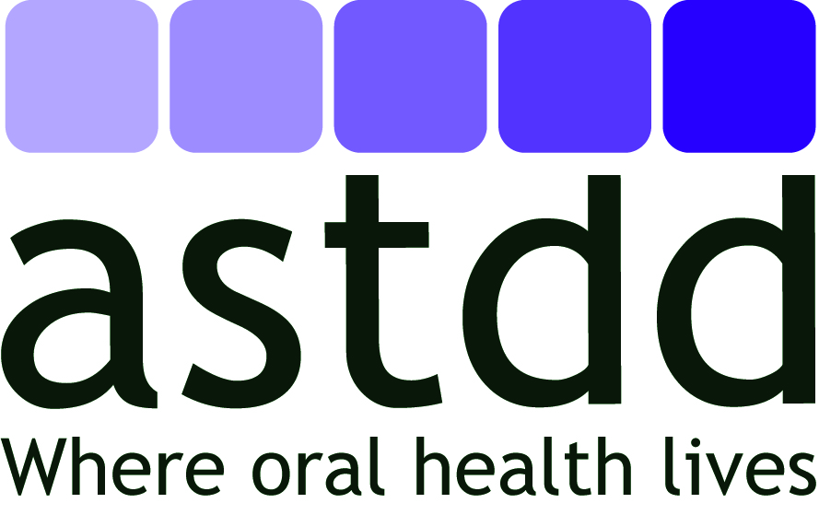
Sample of campaign partners
A campaign with diverse partners:

Slide 27
The web presence
Allowing advocates to create a locally customized web presence for their CWF campaign

Slide 28
PowerPoint slides for advocates

Slide 29
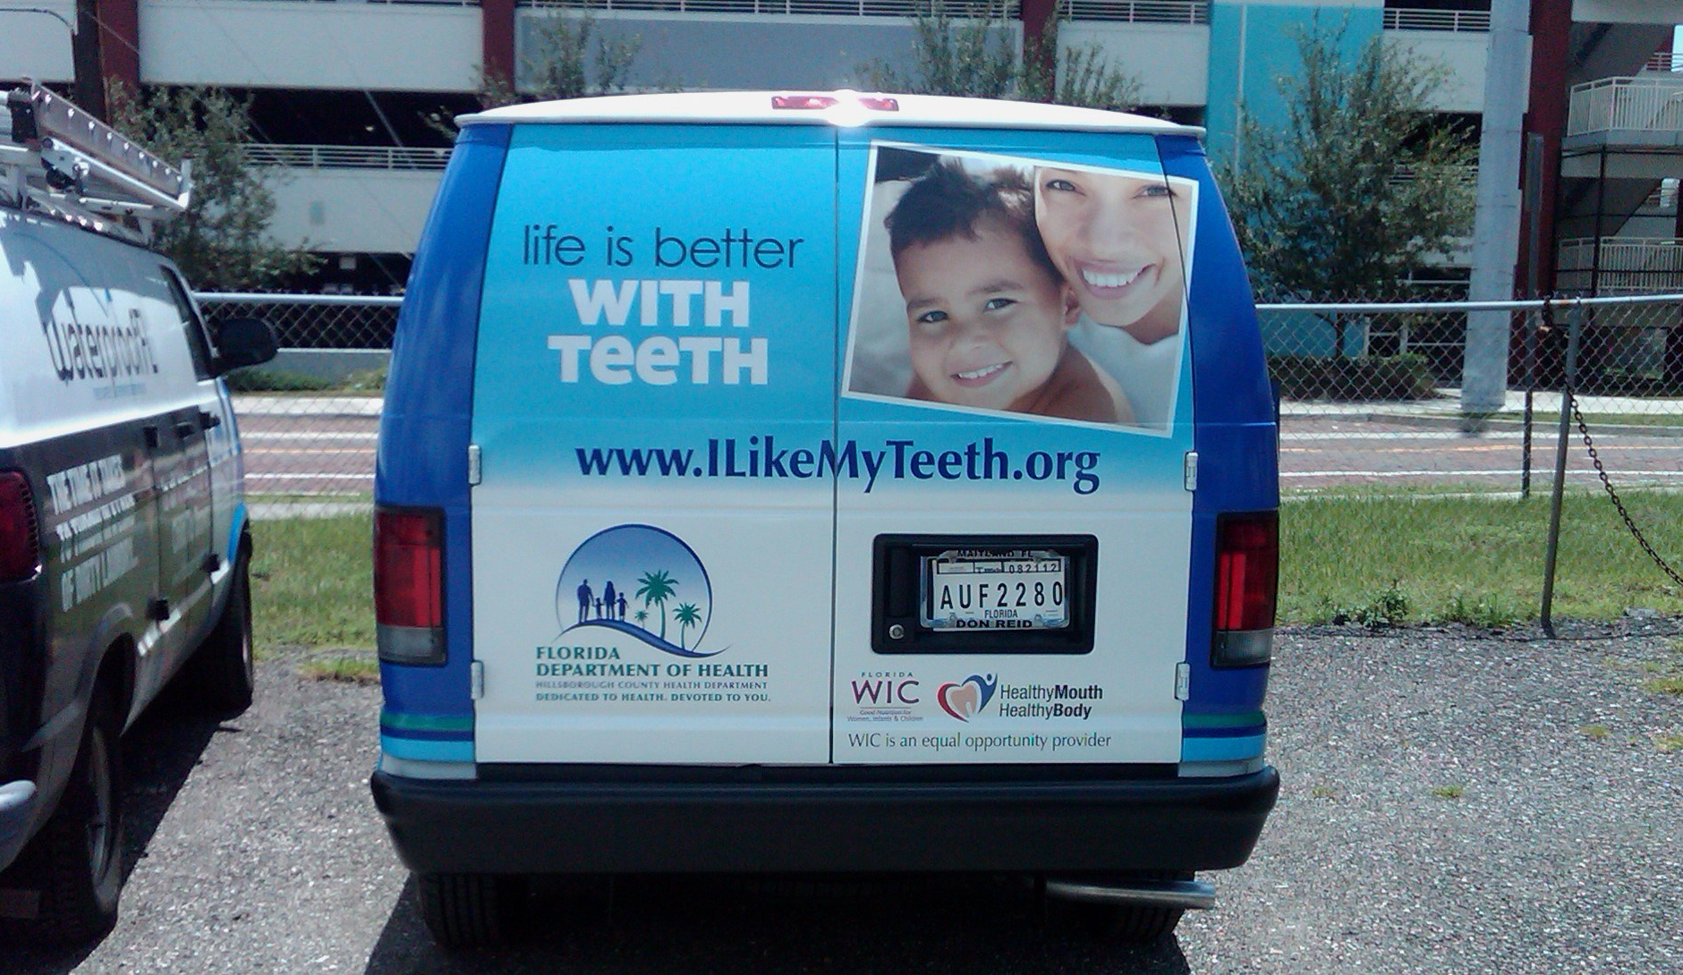
Building awareness of the campaign
Insert Photo of Florida Dental Van

Slide 30
Launching a rapid-response team
Providing balance to the anti-fluoride opinions that used to dominant online discussions

Slide 31
Helping the media frame the issue
-ing water is safe and prevents tooth decay is strong and is widely embraced too. The Centers for Disease Control and Prevention, the U.S. Environmental Protection Agency, the American Dental Association, the Florida Department of Health and the Pinellas County Dental Association stand behind it.
Yet these four county commissioners voted last fall to stop spending $205,000 on fluoridating water to improve the dental health of 700,000 residents. The annual savings per resident works out to 29 cents.
The first U.S. cities began adding fluoride to their water supplies in the 1940s. Now, 196 million Americans are drinking fluoridated water, including more than 13 million Floridians. St. Petersburg, Dunedin, Gulfport and Belleair are on separate systems and continue to fluoridate their drinking water. And so do
Reverse the decay of common sense
Sharing info with editors and reporters, fact-checking stories and encouraging pro-fluoride editorials
This is a defining moment for Pinellas County, where Midwestern sensibilities run deep and extremism usually fails. It's been nearly three months since the county stopped putting fluoride in its drinking water
The reason: Four county commissioners sided with a handful of tea party followers, conspiracy theorists and a tiny anti-fluoride group misnamed Citizens for Safe Water. Nancy Bostock, Neil Brickfield, John Morroni and Norm Roche turned their backs on established science and public health.The evidence that fluoridating drink-

Slide 32
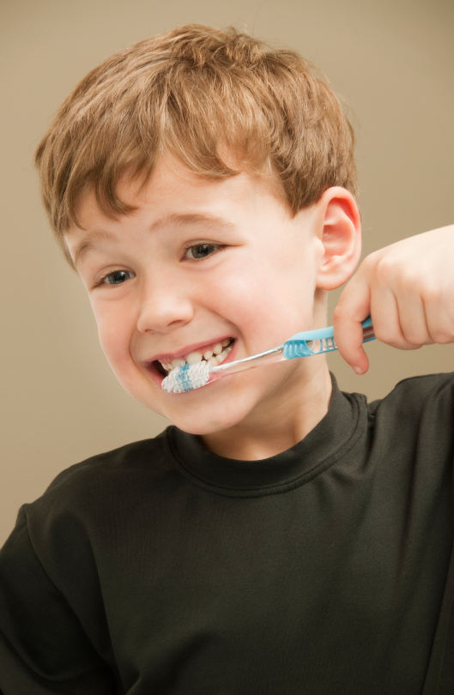
The campaign’s progress
More than 350 users are registered to access advocates-only materials through iLikeMyTeeth.org — a 43% jump since March.
Local websites have been created by advocates in 7 states.
The Campaign provided talking points and other assistance to local advocates in Montana, Florida and Oregon who successfully won local fluoridation votes.
More than 540 Tweets have been sent since our Twitter account was launched in January.
The Campaign has more than 30 local, state and national partners.

Slide 33
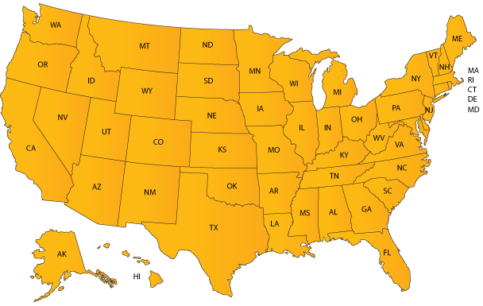
Pew’s outreach to states
OR: Offering funds and research for a campaign in Portland.
MT: Assisted successful effort to preserve CWF in the city of Bozeman.
WI: Provided research and technical assistance to preserve CWF in Milwaukee.
NH: Helped defeat a statewide ban on CWF.
CA: Provided assistance to a successful campaign to secure CWF in San Jose.
MS: Provided message training for oral health field staff.
KS: Assist oral health advocates in Wichita pass a fluoridation policy.
AR: Funded a poll and offered other assistance to pass a state mandate in 2011.
33

Slide 34
Dental Sealants

Slide 35
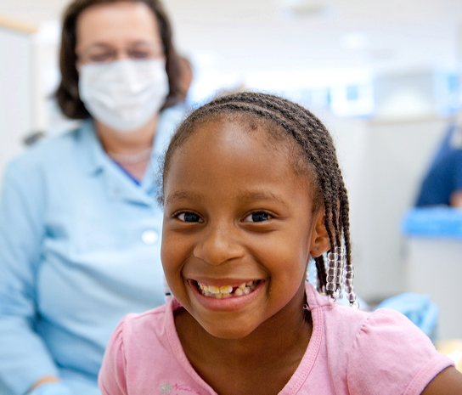
Dental sealants
Dental sealants are clear, plastic coatings that are painted onto children’s molars, which are the most cavity-prone teeth.
Sealants are usually applied when molars first appear in the mouth — at age 6-7 and also at age 12-13.
Sealants prevent 60% of decay at one-third the cost of a filling.
Source: Centers for Disease Control and Prevention, http://www.cdc.gov/oralhealth/publications/factsheets/sealants_faq.htm

Slide 36
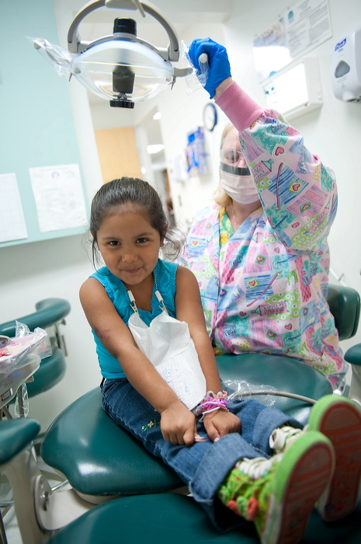
An under-utilized strategy
Despite the proven benefits of sealants for high-risk children:
Only one out of five teenagers aged 13-15 received sealants on at least one of their first set of molars and at least one of their second set of molars.
Between 2005 and 2008, only about 20% of low-income children received sealants, compared with 32% of kids from families at higher income levels.
l
l

Slide 37
An under-utilized strategy
A sealant gap also exists by race and ethnicity
Percentage of children receiving sealants (2005 -2008)
30%
22%
17%
African- Mexican- White
American American

Slide 38
What’s standing in the way of progress?
Dentist’s exam and direct or indirect supervision required (10)
Prior Exam Rules Create Unnecessary Barriers in Many States
WA
MT
ND
ME
Dentist’s exam always required (10)
OR
VT
ID
MN
NH
MA
SD
WI
NY
WY
MI
RI
Dentist’s exam sometimes required (16)
IA
PA
NJ
CT
NV
NE
OH
UT
IL
IN
DE
CA
CO
WV
VA
MD
KS
MO
KY
DC
Dentist’s exam never required (15)
TN
NC
AZ
NM
OK
AR
SC
MS
AL
GA
TX
LA
AK
FL
HI
Source: Pew Center on the States data from survey of state oral health programs and state boards of dentistry, 2011-12.
38

Slide 39
The prior exam rule
It isn’t supported by science.
A CDC panel of experts concluded that a comprehensive dental exam is not required to determine if a tooth should be sealed.
A visual assessment by a hygienist is sufficient before sealants are placed.
It raises the cost of sealant programs.
When Virginia launched a pilot program that lacked a prior exam rule, state officials found that the average per-child cost of this program was 20% lower than applying sealants with a prior exam.

Slide 40
The prior exam rule
It isn’t supported by science.
A CDC panel of experts concluded that a comprehensive dental exam is not required to determine if a tooth should be sealed. A visual assessment by a hygienist is sufficient.
It raises the cost of sealant programs.
When Virginia launched a pilot program that lacked a prior exam rule, state officials found that the average per-child cost of this program was 20% lower than applying sealants with a prior exam.
Pew survey: Reducing restrictions on hygienists was “the most frequently noted policy” that would help to expand school sealant programs.

Slide 41
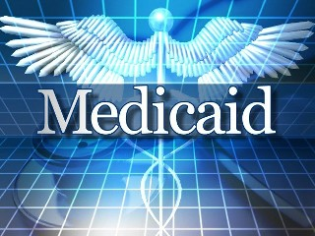
Billing issues can pose obstacles
Only 15 states allow hygienists to bill Medicaid directly for dental services they provide
Arizona
California
Colorado
Connecticut
Maine
Massachusetts
Minnesota
Missouri
Montana
Nebraska
New Mexico
Nevada
Oregon
Washington
Wisconsin
Source: The American Dental Hygienist’s Association

Slide 42
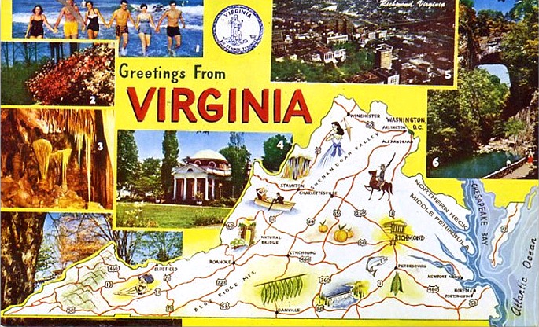
How Pew is helping states
This year, Pew has provided research and technical support to advocates in several states who have worked successfully to change restrictive sealant laws or rules.

Slide 43
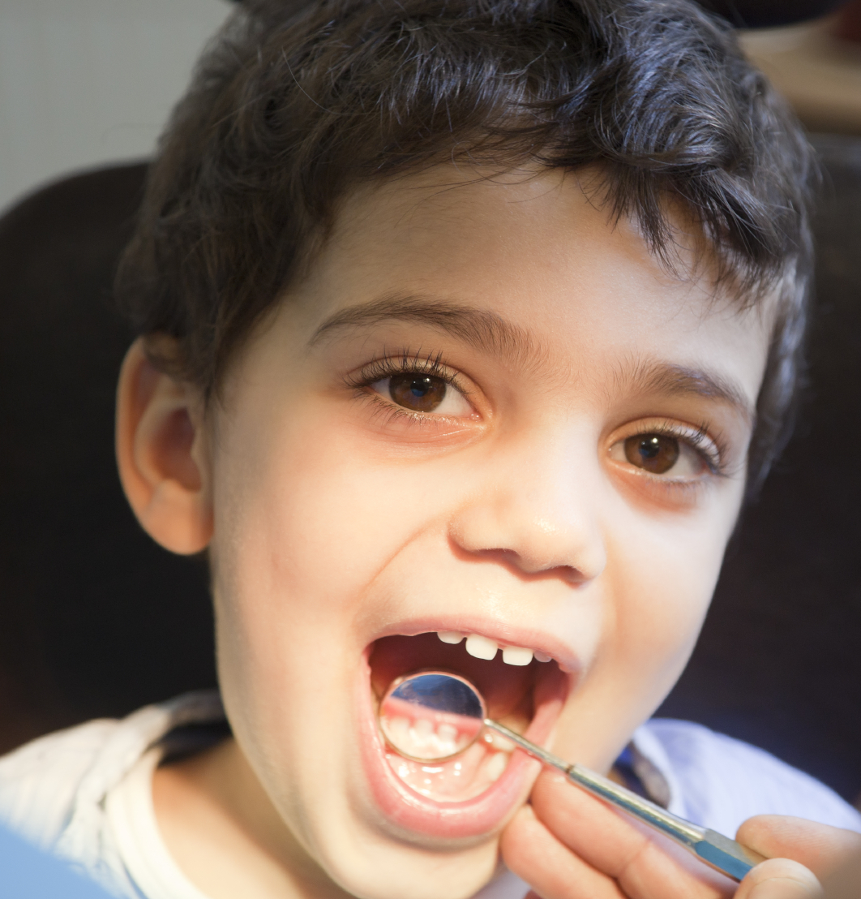
Pew’s upcoming 50-state report
It will grade every state on 4 benchmarks that are related to dental sealants
It will explore whether states are allowing unnecessary rules to obstruct their ability to provide more kids with sealants
It will be released this fall

Slide 44
Keep informed . . .
of these and other oral health issues by receiving Pew's monthly e-newsletter – Dental News & Views.
Send an email to mjacob@pewtrusts.org with the words “Subscribe“
in the subject line.

